Slide 1
Natural Language Processing
Dionisios Karamouzas
Aristotle University of Thessaloniki
dionkara@ece.auth.gr
Version 1.2

Slide 2
Contents
What is Natural Language Processing
History
Symbolic NLP
Statistical NLP
Neural NLP
Methods: Rules, Statistics, Neural networks
Word Representations
Fixed (sparse)
One-hot encoding
Bag-of-words, TF-IDF
Distributed (dense)
Classic embeddings
Contextualized embeddings
Common NLP Tasks

Slide 3
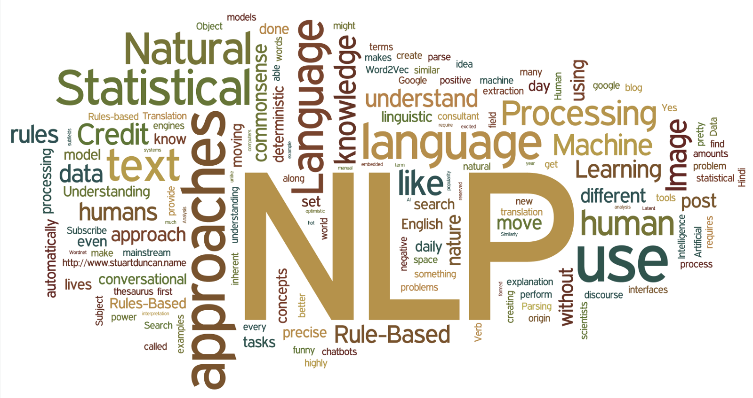
What is NLP ?

Slide 4
Short definition
The automatic manipulation of natural language, like speech and text, by software
or,
Automatic methods that take natural language as input or produce natural language as output
Has been around for more than 50 years and grew out of the field of linguistics with the rise of computers

Slide 5

Natural Language
The way we, humans, communicate with each other
Speech and text
Given the importance of this type of data, we must have methods to understand and reason about natural language

Slide 6
Challenge
Natural Language is :
Messy
Ambiguous
changing and evolving
Not defined by formal rules
So it’s hard working with such data.

Slide 7
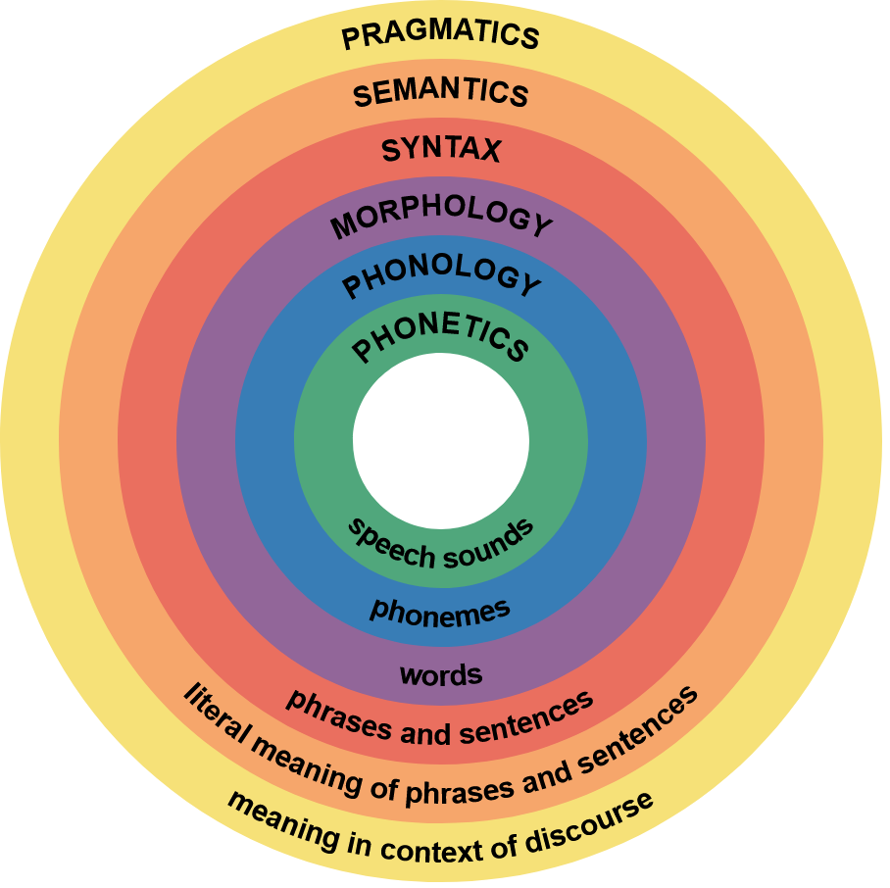
From Linguistics to NLP
Linguistics is the scientific study of language, including its grammar, semantics, and phonetics
Many problems in natural language understanding resist clean mathematical formalisms

Slide 8

Computational Linguistics
The study of linguistics using the tools of computer science
Use computers to handle large text data efficiently and lead to new discoveries

Slide 9
CL vs NLP
Computational linguistics has both a scientific and an engineering side.
Engineering side -> Natural language processing (NLP): building computational tools that do useful things with language
Scientific side -> Seeks to study/understand language using computers and corpora
Same means , different goal
NLP researchers will build a useful system and show that it works really well
CL researcher would be more interested in which features are useful indicators and why

Slide 10
History

Slide 11
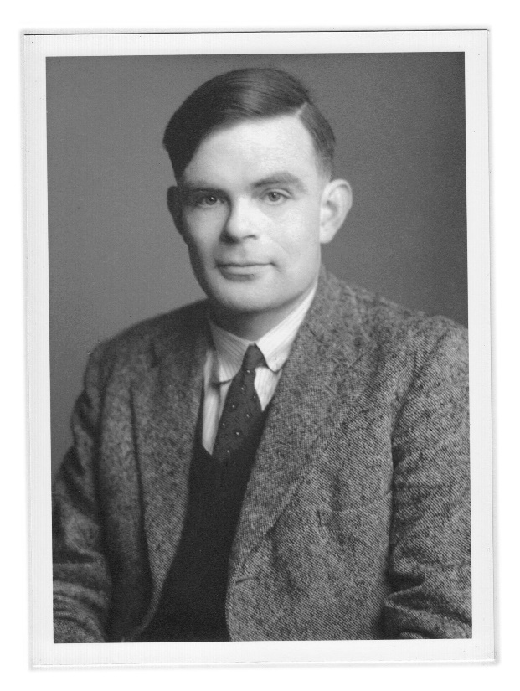
Roots
Alan Turing ,1950, "Computing Machinery and Intelligence" , Turing test -> Test if a machine exhibits human-like intelligence
This task involves the automated interpretation and generation of natural language

Slide 12
History - periods
Symbolic NLP (1950s - early 1990s)
Statistical NLP (1990s - 2010s)
Neural NLP (2010s - present)

Slide 13
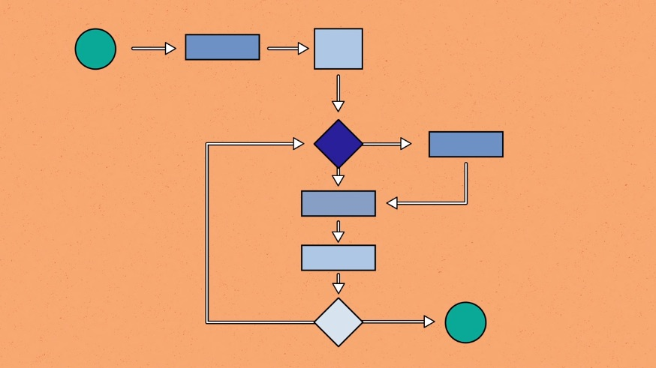
Symbolic NLP (classical programming)
Given a collection of hand written rules the computer emulates natural language understanding by applying those rules to the data it is confronted with

Slide 14
Symbolic NLP
1950s: Georgetown experiment - fully automatic translation
1960s: ELIZA - a simulation of a psychotherapist
1970s: PARRY - the first chatterbot
1980s: Lesk algorithm - rule-based parsing, semantics

Slide 15
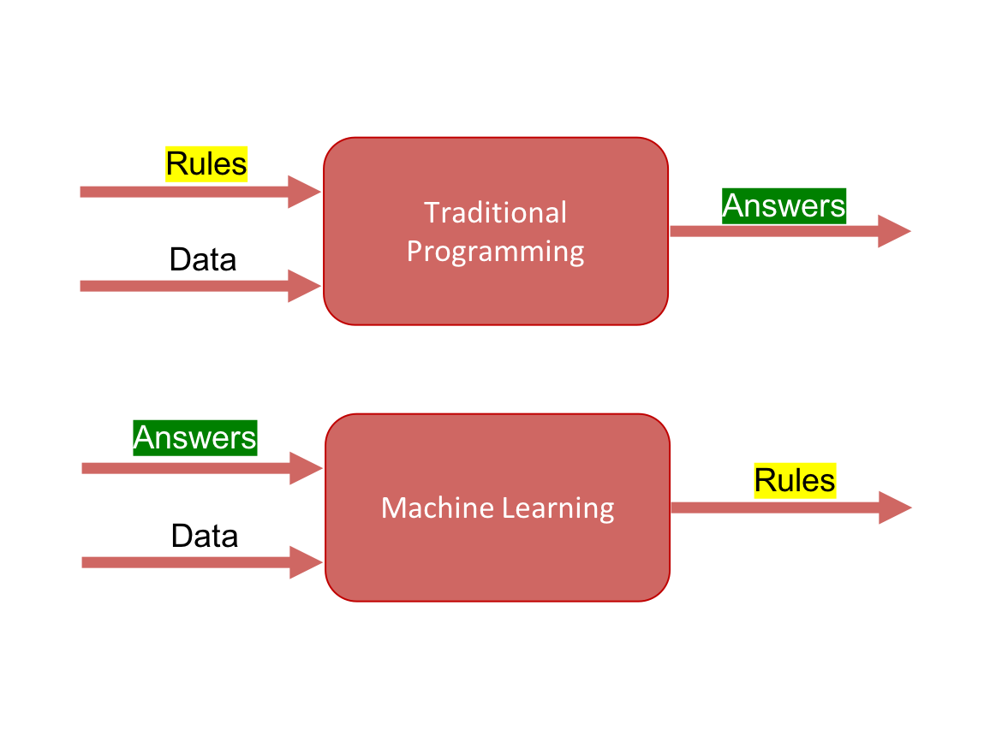
Statistical NLP
Up to 1980s -> hand-written rules
Late 1980s -> statistical approach / Data-Driven methods / machine learning algorithms

Slide 16
Why Statistical NLP
Increase in computational power
Gradual lessening of the dominance of Chomskyan theories of linguistics
Better results, speed, and robustness
Increased amount of data
Disenchantment with symbolic top-down approaches

Slide 17
Statistical NLP
1990s: Machine translation by IBM , limited amounts of data
2000s:
Supervised learning -> easier, better results -> lack of annotated datasets
Web growth -> more raw (unannotated) data -> unsupervised and semi-supervised learning -> large datasets and low time complexity can compensate for low accuracies

Slide 18
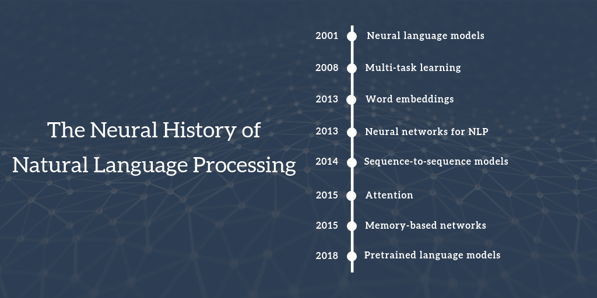
Neural NLP

Slide 19
Neural NLP
2001 - Neural language models: A feed-forward neural network was proposed by Bengio et al. for language modelling
2008 - Multi-task learning: Sharing the look-up tables (word vectors) between two models trained on different tasks was proposed by Collobert et al.
2013 - Word embeddings: Word2Vec was proposed by Mikolov et al. to learn vector representations from huge corpora

Slide 20
Neural NLP
2013 - Neural networks for NLP: RNNs (Sutskever et al.) and CNNs (Kalchbrenner et al.) started to get adopted in NLP, as well as the combination of those (Wang et al.)
2014 - Sequence-to-sequence models: Encoder – Decoder architecture proposed by Sutskever et al.
2015 - Attention: This mechanism, proposed by Bahdanau et al., allowed the decoder to look back at the source sequence hidden states

Slide 21
Neural NLP
2015 - Memory-based networks: Models with a more explicit memory have been proposed by Graves et al., Weston et al.
2018 - Pretrained language models: Language models trained in huge corpora to find good embeddings can now be used for diverse range of downstream tasks – e.g BERT, proposed by Devlin et al. which is the current SOTA across a variety of NLP tasks

Slide 22
Methods: Rules, statistics, neural networks

Slide 23

Rules
Hand-coding of a set of rules, coupled with a dictionary lookup: such as by writing grammars or devising heuristic rules for stemming

Slide 24
Statistics
Statistical revolution (1990s) -> Machine learning
Machine-learning -> Using statistical inference to automatically learn such rules through the analysis of large corpora
These algorithms take as input a large set of "features" that are generated from the input data by the programmer (manually)

Slide 25
Why ML ?
Cons of hand-crafted rules
Not at all obvious where the effort should be directed
Handling unfamiliar and erroneous input is extremely difficult
Systems can only be made more accurate by increasing the complexity of the rules -> hard process

Slide 26
ML Algorithms for NLP
Supervised ML
Unsupervised ML
Support Vector Machines
Bayesian Networks
Maximum Entropy
Conditional Random Field
Decision Trees
Random Forests
K-nearest Neighbor
Clustering
Latent Semantic Indexing
Matrix Factorization

Slide 27
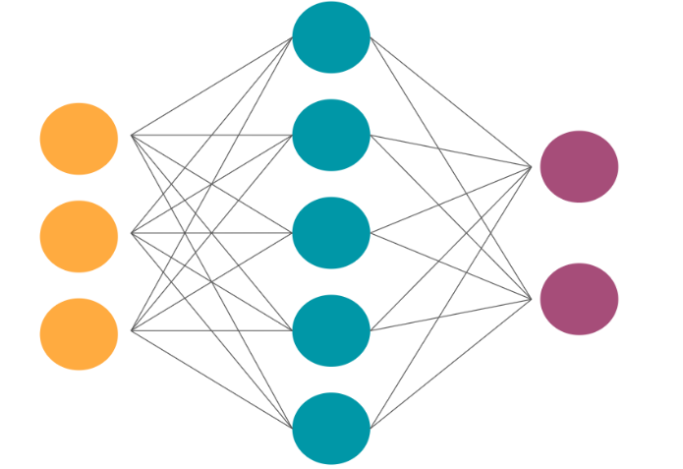
Neural Networks
Since the neural turn (early 2010s), statistical methods in NLP research have been largely replaced by neural networks
Better performance, more data but less linguistic expertise to train and operate

Slide 28
Why NNs
Cons of statistical methods:
Elaborate feature engineering
Relying on a pipeline of separate intermediate tasks for learning a higher-level task

Slide 29
NNs Feature Learning
ML methods -> Manual Feature Extraction
Cons of manually designed features
Overspecified or incomplete
Long time to design and validate
Only get you to a certain level of performance

Slide 30
NNs Feature Learning
Neural networks -> automatic feature learning
Pros of learned features
Continually and automatically improve
Easy to adapt
Fast to train

Slide 31
NNs End-to-End
One neural network to learn the whole problem end-to-end rather than pipelines of specialized systems
Speed and simplicity of development
Improved performance

Slide 32
Types of NNs for NLP
Embedding Layers
Multilayer Perceptrons (MLP)
Convolutional Neural Networks (CNNs)
Recurrent Neural Networks (RNNs)
Hybrid – Combinational Neural Networks

Slide 33
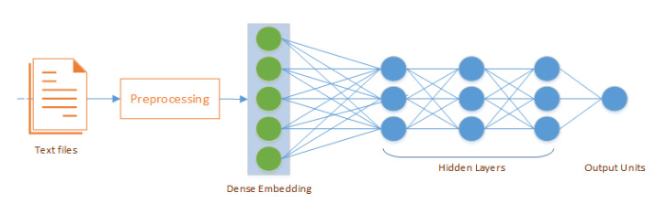
Embedding Layer
Used on the front end of a neural network
The one-hot encoded words are mapped to the word vectors
Word vectors are concatenated before being fed as input to an MLP
Each word may be taken as one input in a sequence when using RNN

Slide 34
Embedding Layer
It can be used alone to learn a word embedding that can be saved and used in another model later
It can be used as part of a deep learning model where the embedding is learned along with the model itself trained on a specific NLP task
It can be used to load a pre-trained word embedding model, a type of transfer learning
Learning a word embedding -> Time consuming , Lots of data

Slide 35
Embedding Layer
3 arguments:
input_dim: Size of the vocabulary (# of unique words in a corpus)
output_dim: Size of each word embedding vector (e.g. 200d vector)
input_length: Length of input sequences (e.g. Tweet – 15 words)

Slide 36
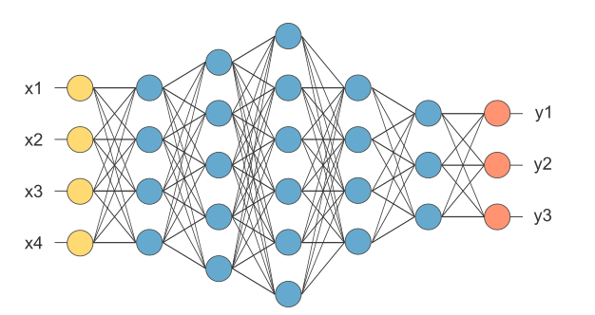
MLP

Slide 37
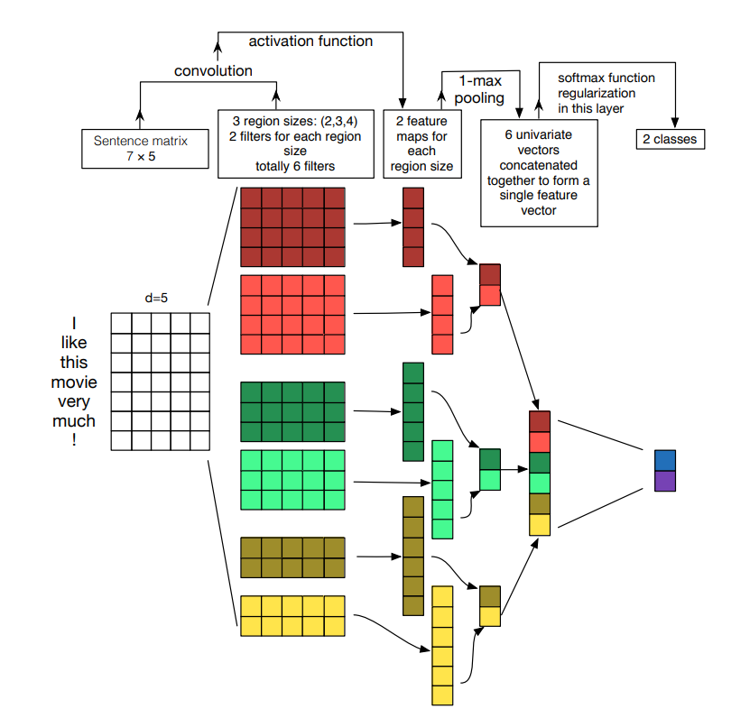
Convolution Neural Networks (CNNs)
Traditionally used in image processing
Can be also used for text
Easily parallelized for GPUs
Good classification results
Source: Zhang and Wallace (2015)

Slide 38

Recurrent Neural Networks (RNNs)
Good for dealing with sequential data (as text)
Consider information of previous nodes
Why is it useful ?
Example: Try to predict the direction of a ball moving
RNNs mostly works by using LSTM or GRU for text classification (due to vanishing gradient problem)
Source: colah’s blog
Source: link

Slide 39
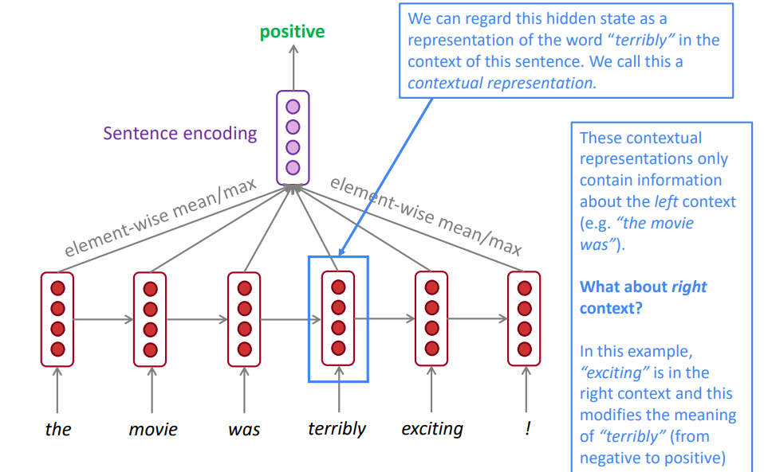
Recurrent Neural Networks (RNNs)
Other types
Bi-directional RNNs
Multi-layer RNNs
Disadvantages
Slow
Difficult to be parallelized
Source: Stanford’s lectures from Natural Language Processing with Deep Learning CS224N/Ling284

Slide 40
RNN vs CNN
RNN
CNN
Recognize patterns across time
Comprehension of global/long-range semantics
Account for the order of words in text
All sequential data tasks: Question-Answering, Machine Translation, POS tagging, Image Captioning, Language Modeling etc.
Slow training – can’t use parallelism
Recognize patterns across space
Local feature detection
Don’t account for the order of words (convolution + pooling)
Only Classification tasks: Sentiment Analysis, Spam Detection, Topic Categorization
Fast training (~5x) – GPU utilization for convolutions

Slide 41
Hybrid NNs
CNN + RNN
RNN + CNN
CNN // RNN

Slide 42
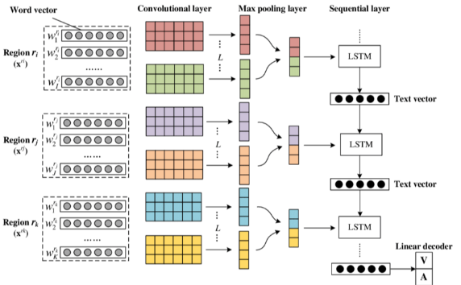
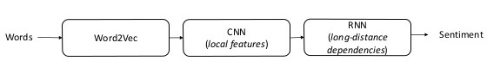
CNN + RNN
Takes advantage of the coarse grained local features generated by CNN and long-distance dependencies learned via RNN

Slide 43
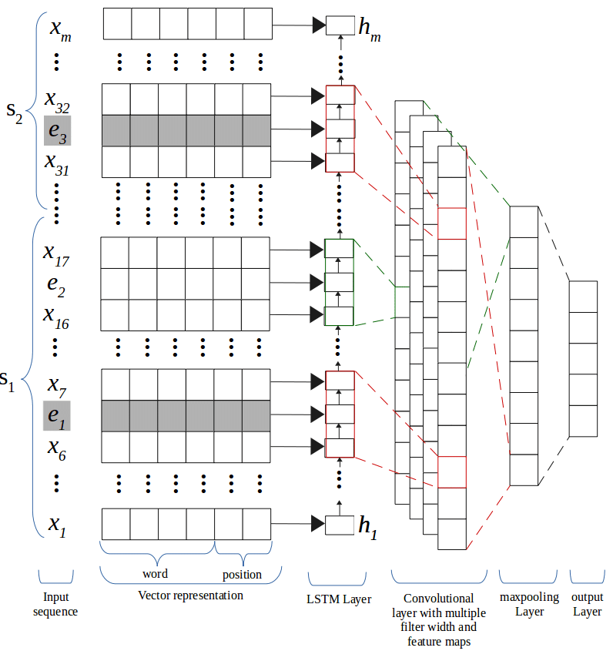
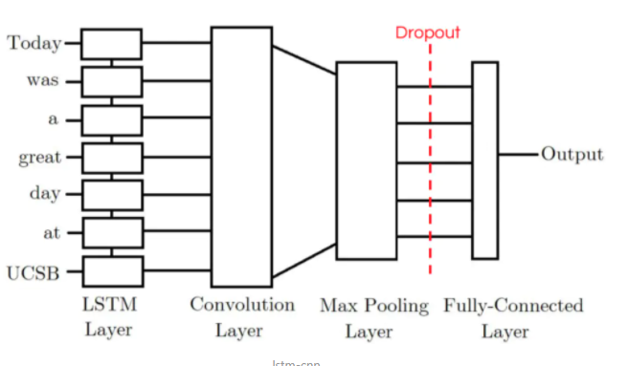
RNN + CNN

Slide 44
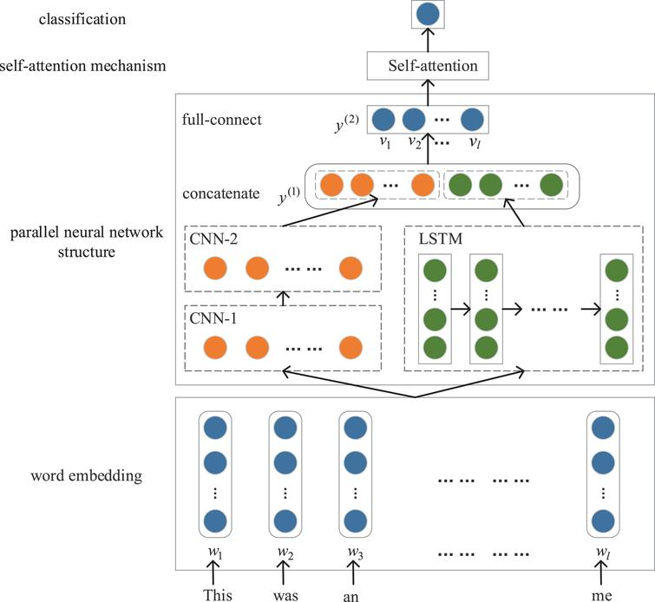
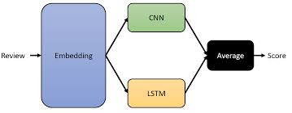
CNN // RNN

Slide 45
Word representations
Words represented as vectors

Slide 46
Word representations (vectors)
Fixed representations (sparse)
Every dimension/value of the feature vector corresponds to a specific word
Distributed representations (dense)
Features/dimensions of the vector do not correspond to words from the vocabulary but to some meaning/entity

Slide 47
Fixed representations
One-Hot Encoding
Bag of words (count vectors), TF-IDF

Slide 48
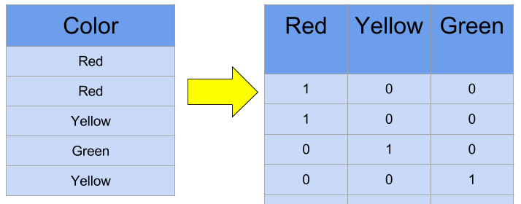
One-Hot Encoding
Vocabulary size vector
Only corresponding column value is 1

Slide 49
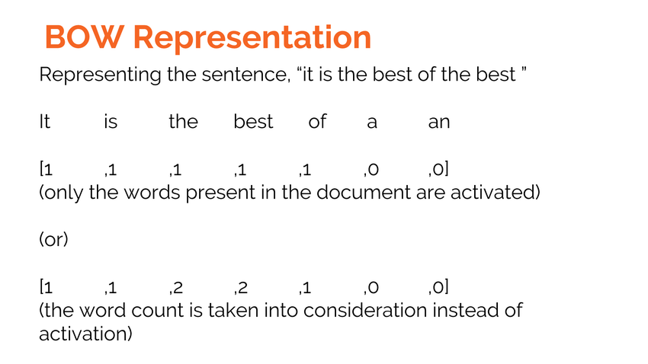
Bag of words
Represent context (phrases, sentences, paragraphs, documents)
Binary values (binary BOW)
Frequency counts (BOW)

Slide 50
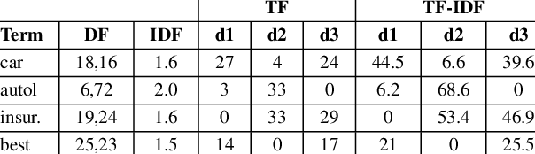
TF-IDF
Term Frequency-Inverse Document Frequency scores

Slide 51
Fixed representations
Cons
Pros
Require large memory
No semantic information
Easy to use

Slide 52
Distributed representations (embeddings)
Classic word embeddings
Word2Vec (T. Mikolov et al, 2013)
GloVe (J. Pennington et al, 2014)
FastText (P. Bojanowski et al, 2016)
Contextualized word embeddings
CoVe (B. McCann et al, 2017)
ELMo (M. Peters et al, 2018)
GPT (OpenAI, 2018)
BERT (J. Devlin et al, 2018)

Slide 53
About Embeddings
Word semantics are embedded in the vector representation
Similar meanings -> similar representations
Embedding values are learned like the weights of a NN in training
Language models are used to train/learn good embeddings with large corpora, in a word prediction task

Slide 54
Classic word embeddings
Language models for learning embeddings

Slide 55
Word2Vec
Two-layer NN trained to reconstruct linguistic contexts of words
Training with pairs of context-target words (2 variations)
Skip-gram (popular): The embeddings are learned while the model tries to predict the context given the target word as input
CBOW: The context words embeddings are randomly initialized and learned while the model tries to predict the target word given the context as input

Slide 56
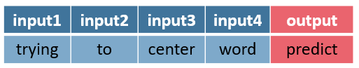
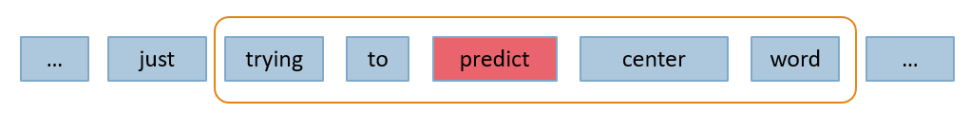
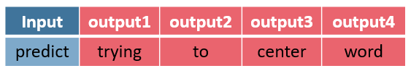
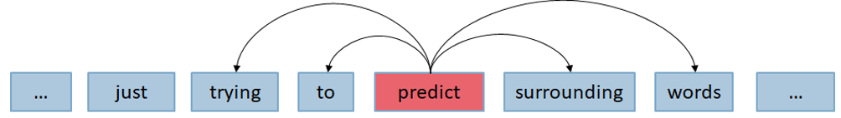
Word2Vec (concept)
Continuous Bag-of-Words (CBOW)
Predict center word given surrounding words
Skip-Gram
Predict surrounding words given center word

Slide 57
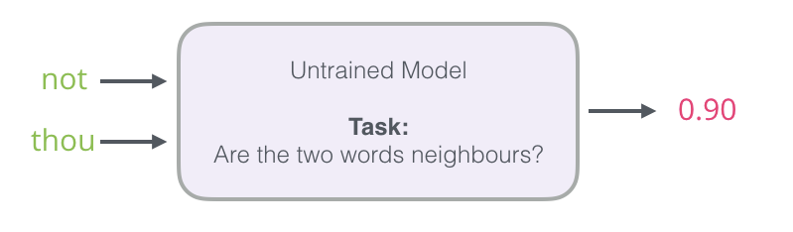
Skip-gram
Instead of asking the model to predict the neighboring word, ask it if a word is neighbor
This makes processing much faster and allows training on huge corpora -> better embeddings

Slide 58
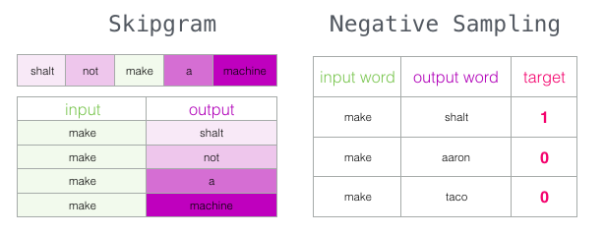
Negative sampling
To balance the training dataset and avoid getting a ‘smartass’ model that gives garbage embeddings, negative sampling is employed
For each sample in the initial dataset, random words from the vocabulary – not neighbors – are put as negative examples

Slide 59
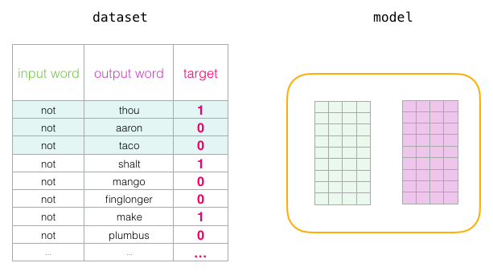
Training process
First, embedding and context matrices are created (both vocab_size x embedding_size)
These two have an embedding for each word and are getting updated during training
The goal of training is to get a good embedding matrix with all the word representations
We can then load that pretrained matrix to deal with any NLP task

Slide 60
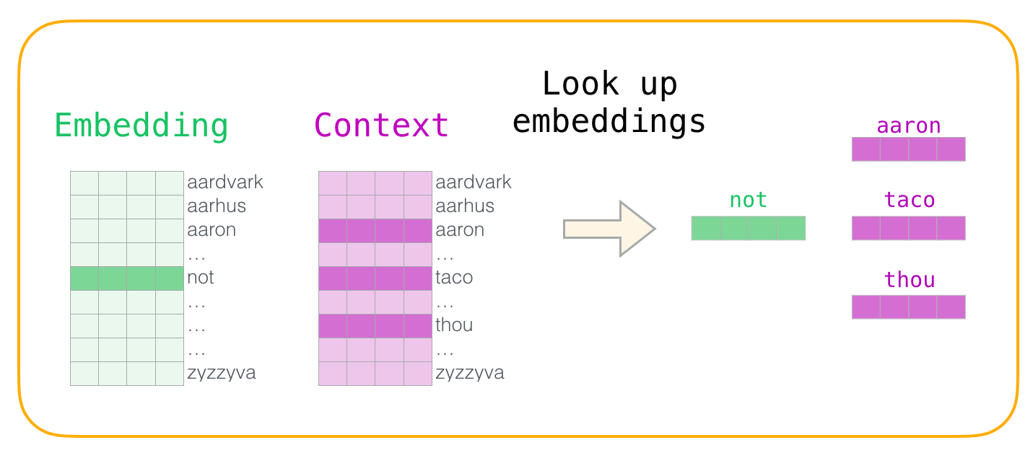
Training process
Each training step: Take one positive example and its associated negative examples
Look up embeddings: Input words -> Embedding matrix, Output/context words -> Context matrix

Slide 61

Training process
Take the dot product of the corresponding embeddings - that number indicates the similarity of the input and context embeddings
Use sigmoid (suitable for binary classification) to get the model’s output
Calculate prediction error and use it to update model parameters (the two matrices)
Iterate through the whole dataset to get a well-trained embedding matrix

Slide 62
GloVe
Marry the global text statistics of matrix factorization techniques like Latent Semantic Analysis with the local context-based learning in word2vec
Constructs a matrix of term co-occurrences from the whole corpus
For each word (e.g. water), compute P(k|water) = probability of k and water to co-occur, where k=word from the vocabulary
High-dimensional context matrix is reduced by normalizing counts and log-smoothing

Slide 63
FastText
Extends word2vec’s skip-gram model which ignored the internal structure of words, by taking into account morphology
Subword units are considered, and words are represented by the sum of the vector representations of its character n-grams + word itself
Example: where, n=3 -> <wh, whe, her, ere, re>, <where>
Sharing the representations across words allows to learn reliable representations for rare words (previous models produced poor embeddings for rare words)

Slide 64
Word embeddings
Problem: Polysemy – same word has different meaning based on its context
Solution: Contextualized embeddings – take into account the context of word

Slide 65
Contextualized word embeddings
Language models for learning contextualized embeddings

Slide 66
CoVe
Embeddings are learned in a translation task
Encoder-decoder model is trained (supervised)
Encoder: two-layer bidirectional LSTM
Decoder: attentional unidirectional LSTMs
Encoder must learn how to capture syntactic and semantic meanings of words, and output contextualized embeddings
Then, this pre-trained encoder can be used for a downstream task

Slide 67
CoVe
Limitations
Supervised training - limited labeled data
Downstream task architecture still needs to be defined
What we want
Unsupervised training - unlimited data
Apply on downstream tasks with small architecture changes

Slide 68
ELMo
Embeddings are learned by training a language model in an unsupervised manner
Architecture : stacked bidirectional LSTMs
The model learns to predict the next/previous word given the previous/next ones (bidirectional)
Still an extra model is needed for downstream tasks (ELMo only gives us the embeddings)

Slide 69
Transformer
New era in NLP

Slide 70
Transformer
Deep learning model proposed by Vaswani et al. (2017), in “Attention is all you need” paper
Based on seq2seq (encoder-decoder) architecture proposed by Sutskever et al. (2014) and the attention mechanism proposed by Bahdanau et al. (2015)
Originally used in NLP – Machine Translation, text summarization but is also found in Computer vision tasks
SOTA language models like BERT are based on its architecture

Slide 71
Transformer vs RNN
Similarities
Both can handle sequential input data
Differences
Transformers process the whole input sequence at once (due to the attention mechanism), not sequentially (word-by-word) like RNNs
This feature allows for more parallelization than RNNs and therefore reduces training times.
The additional training parallelization allows training on larger datasets
This led to the development of pretrained language models such as BERT and GPT

Slide 72
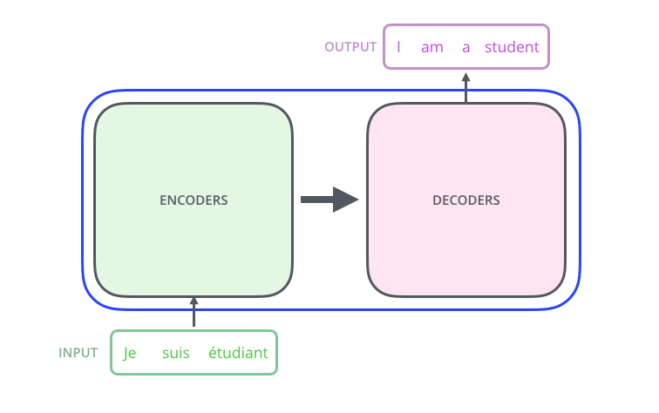
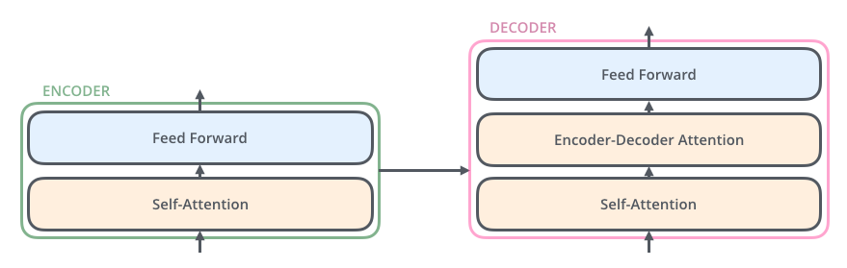
Transformer – basic blocks
Self-attention layer helps the encoder look at other words in the input sentence as it encodes a specific word
Decoder has an extra attention layer that helps focus on relevant parts of the input sentence
6 encoders and 6 decoders in each stack in the original architecture

Slide 73
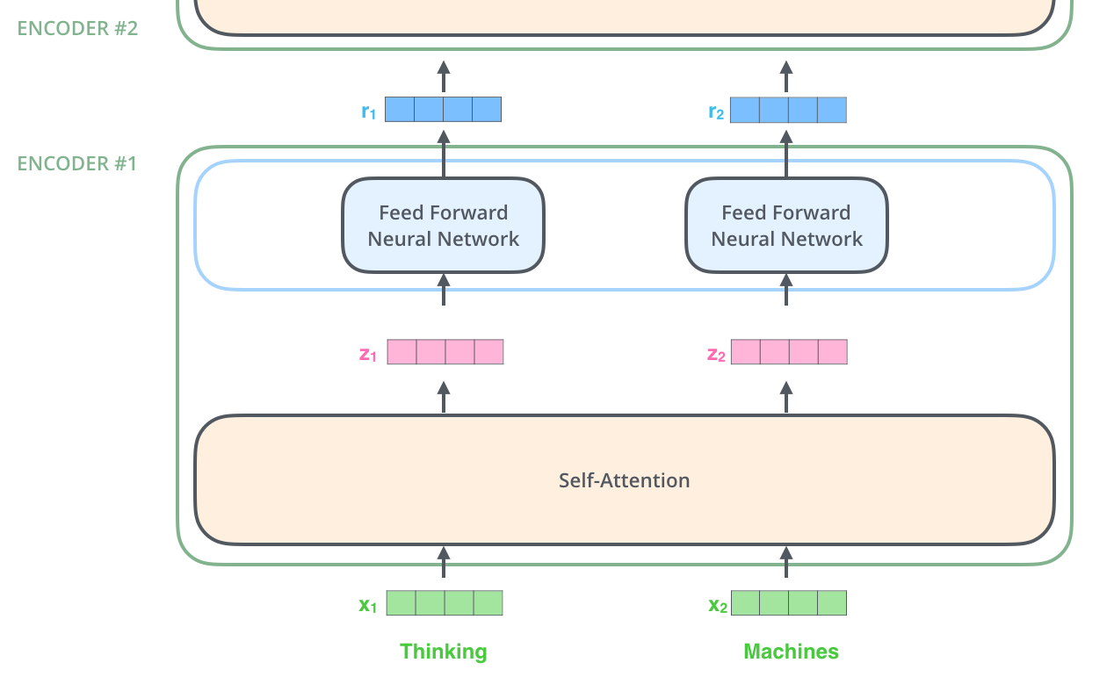
Encoder data flow
All the encoders receive a list of vectors each of the size 512
They pass these vectors into a self-attention layer, then into a feed-forward neural network which sends out the output upwards to the next encoder

Slide 74
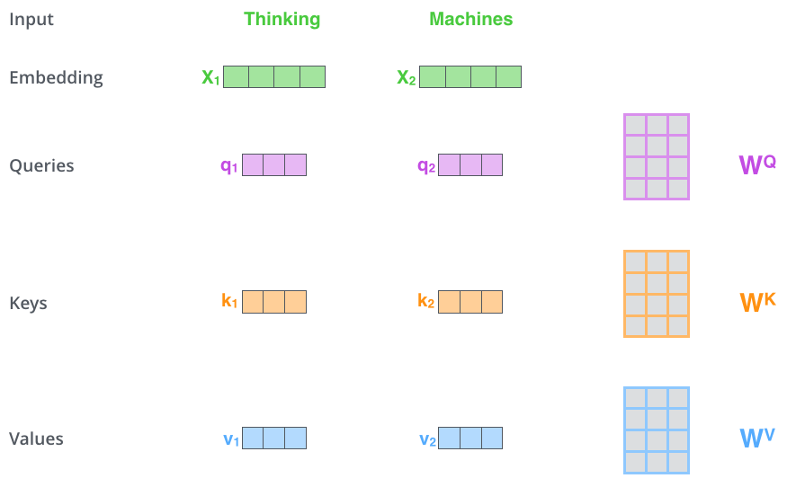
Self-attention
1. Create Query, Key and Value vectors (size=64) from each of the encoder’s input vectors (size=512)
These vectors are created by multiplying the input vectors by Wq, Wk, Wv matrices that we trained during the training process
For the first only encoder the input vectors are the initial word embeddings (as depicted)

Slide 75
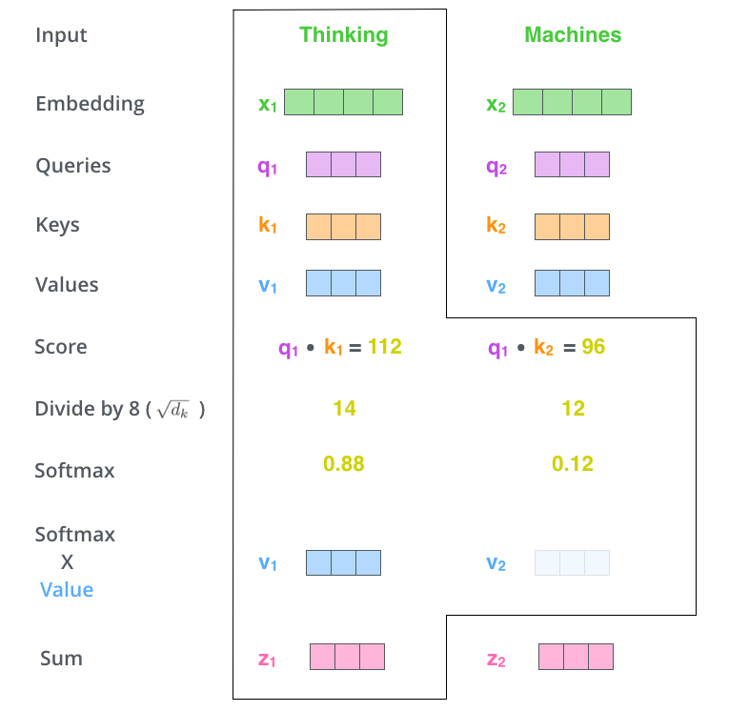
Self-attention
4. Pass the result through a softmax operation to normalize the scores. This softmax score determines how much each word will be expressed at this position
5. Multiply each value vector by the softmax score
6. Sum up the weighted value vectors to produce the output of the self-attention layer at this position
2. Using q,k calculate a score for each word that determines how much focus to place on other parts of the input sentence as we encode a word at a certain position.
3. Divide the scores by the square root of the dimension of the key vectors

Slide 76
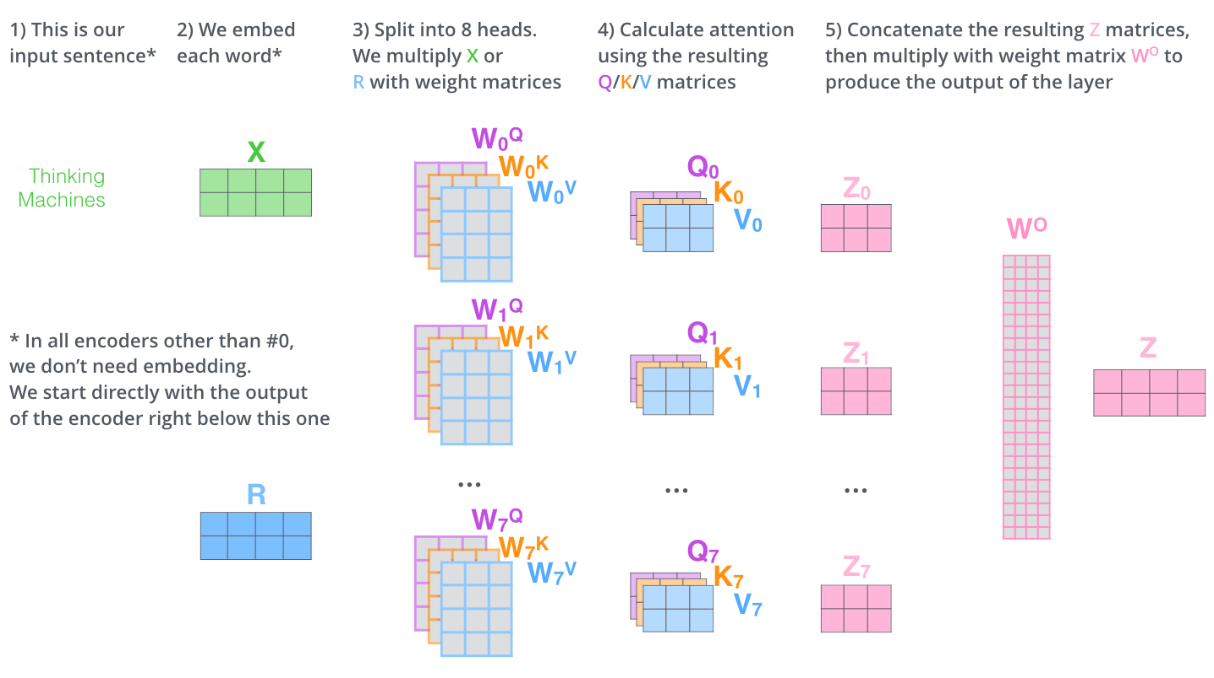
Multi-headed attention
We do the same self-attention calculation eight different times with different weight matrices, we end up with eight different Z matrices
The feed-forward layer expects a single matrix not eight
Concat the matrices then multiply them by an additional weights matrix WO to get the final Z matrix.

Slide 77
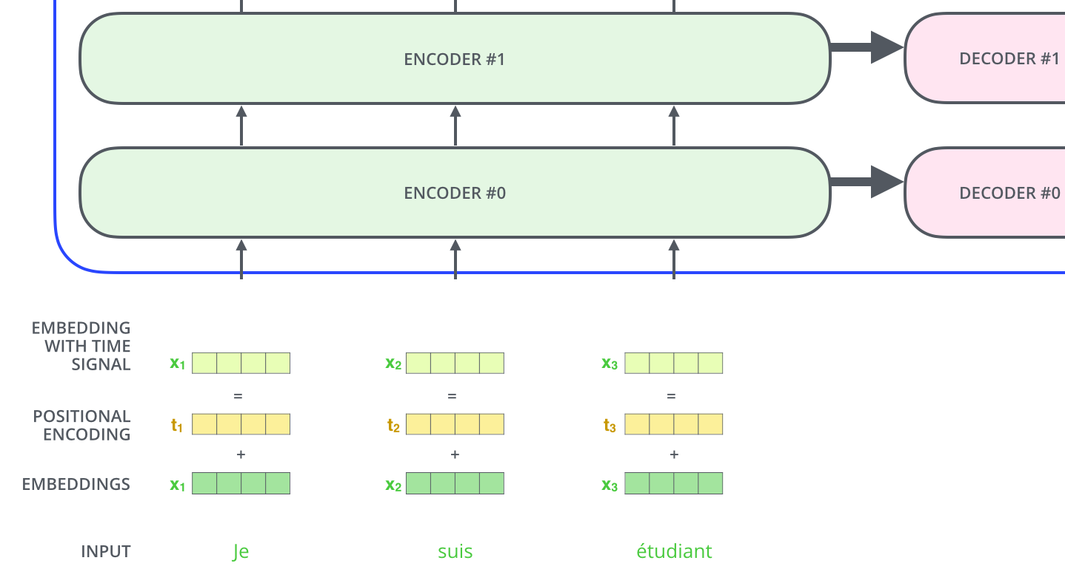
Positional encodings
To account for the order of the words in the input sequence, the transformer adds a vector - positional encoding - to each input embedding

Slide 78
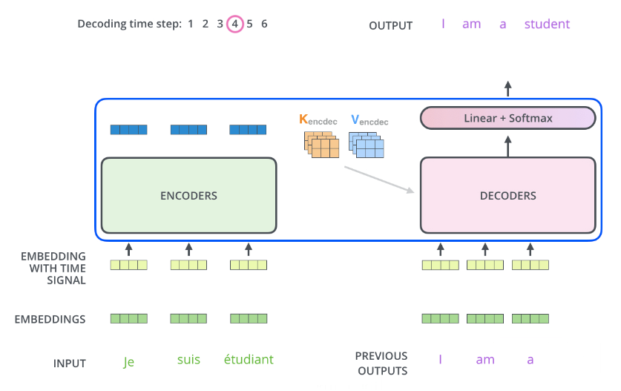
Decoder
Encoder processes the input sequence and the top encoder output is transformed into a set of attention vectors K and V
K,V are used by each decoder in its “encoder-decoder attention” layer which helps the decoder focus on appropriate places in the input sequence
The output of each step is fed to the bottom decoder in the next time step
Positional encodings are also added to those decoder inputs to indicate the position of each word

Slide 79
Decoder
In decoder, self-attention layer can only attend to earlier positions in the output sequence
The Encoder-Decoder Attention creates its Queries matrix from the layer below it, and takes the Keys and Values matrix from the output of the encoder stack

Slide 80
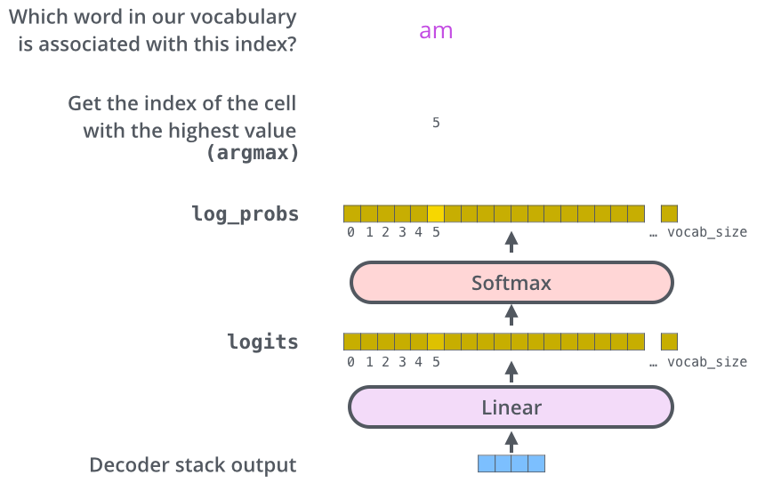
Final output
Linear layer (FC) : Projects the vector produced by the stack of decoders, into a much larger vector called a logits vector.
Logits vector size = output vocabulary size (each cell corresponds to the score of a unique word)
Softmax layer : Turns those scores into probabilities. The cell with the highest probability is chosen, and the word associated with it is produced as the output for this time step.

Slide 81
Pretrained language models based on Transformer

Slide 82
OpenAI GPT
Unlike ELMo, GPT is trained only to predict the future
Architecture : Based on Transformer’s decoder
Can be used directly for all end tasks with only slight modifications
vs ELMo
ELMo gives richer embeddings due to its bidirectional nature (understands better the context of the word)
ELMo can’t be used directly for all end tasks (only encoding-front end)

Slide 83

BERT

Slide 84
BERT
Architecture : Multi-layer bidirectional Transformer encoder
It’s pre-training (unsupervised) consists of two tasks:
Mask Language Model: Find the masked/hidden words by looking at their context
Next Sentence Prediction: With two sentences as inputs, A and B, determine if B is following A or not
Trained to predict the context from both left and right (bidirectional)
Can be used directly for downstream tasks with small modifications

Slide 85
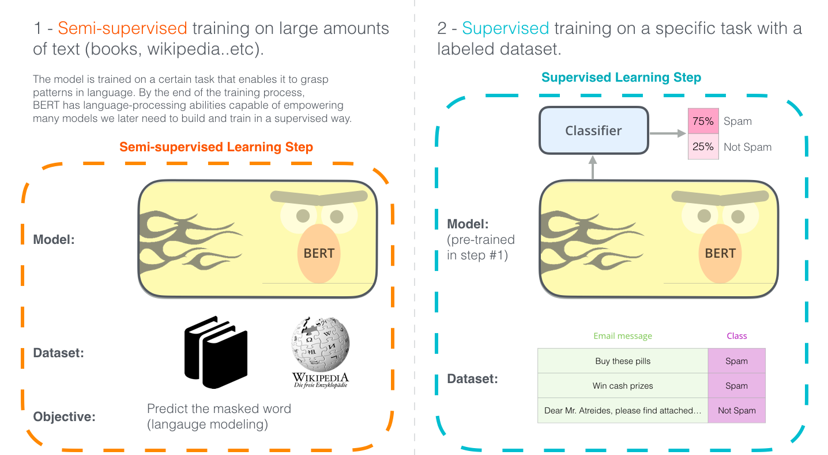
BERT
For downstream tasks (text classification) BERT is loaded pretrained and with some extra layers on top is fine-tuned to the specific task, in a supervised manner

Slide 86
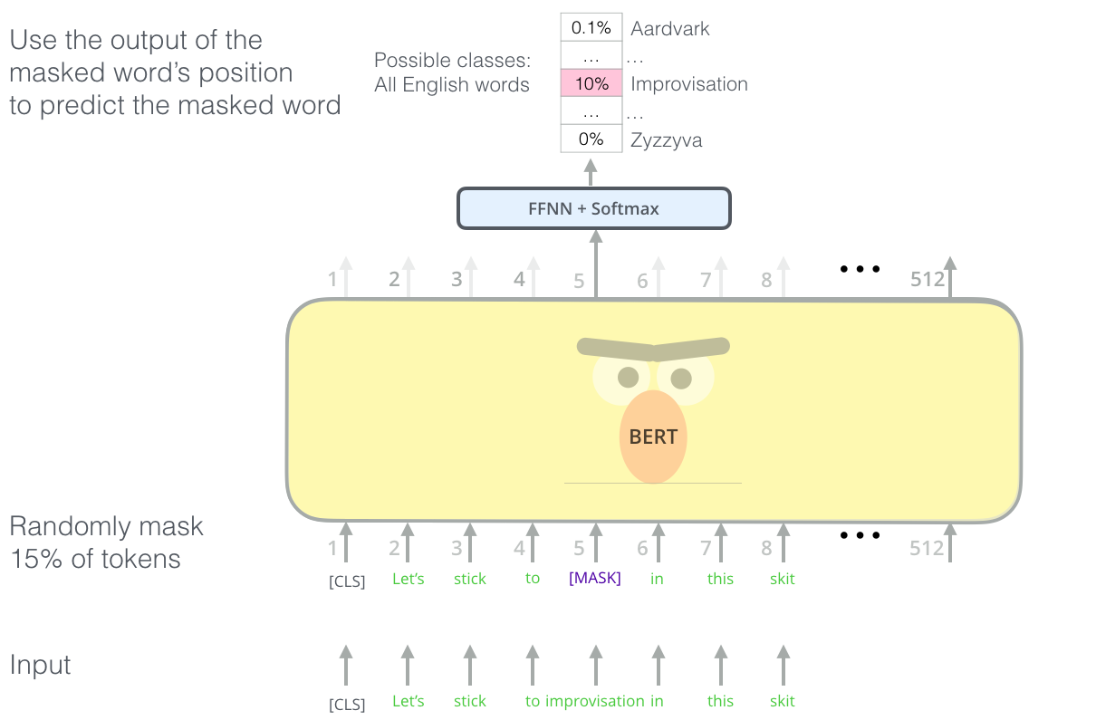
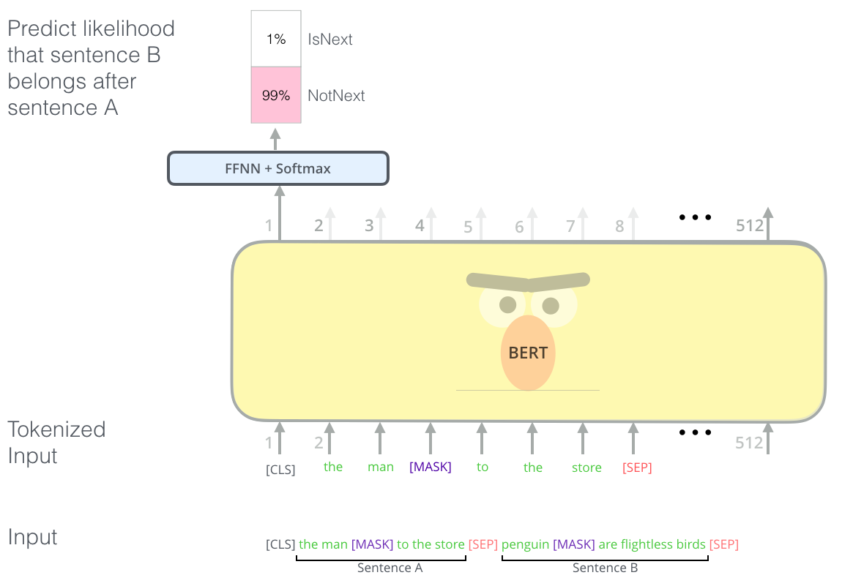
BERT pre-training
Masked Language Model
Next sentence prediction

Slide 87
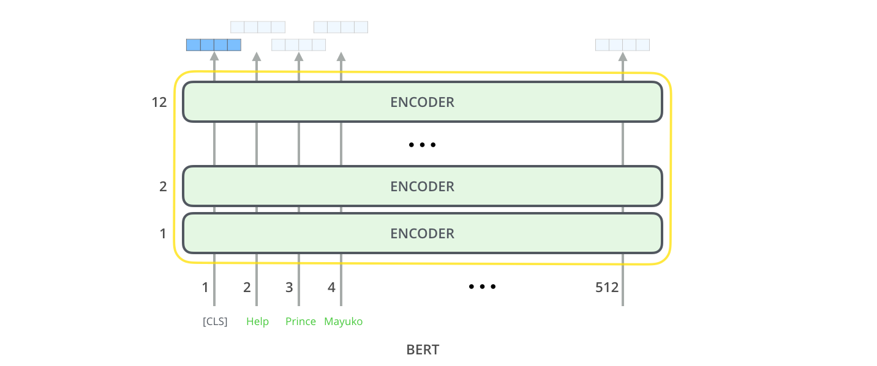
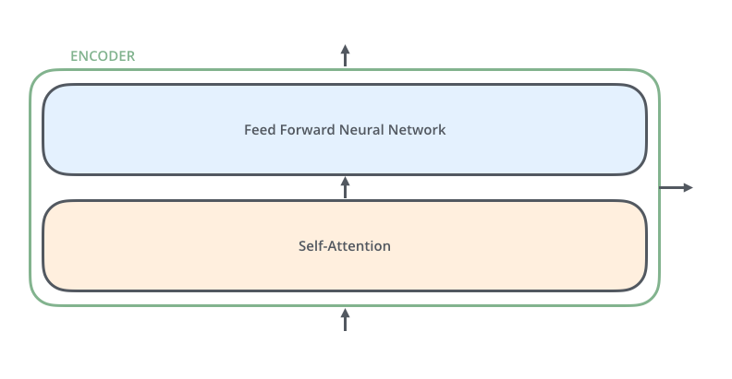
BERT embeddings
The embeddings produced for each word contain info from context (due to self-attention layer inside each encoder)
We can take the output vectors of whichever encoder we want but usually prefer the last one
Embedding size = Hidden layer size of FFNN inside the encoder

Slide 88
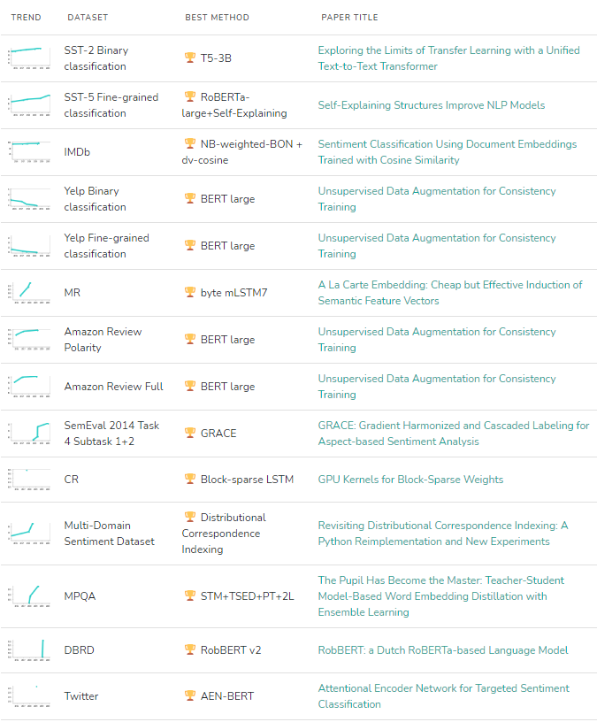
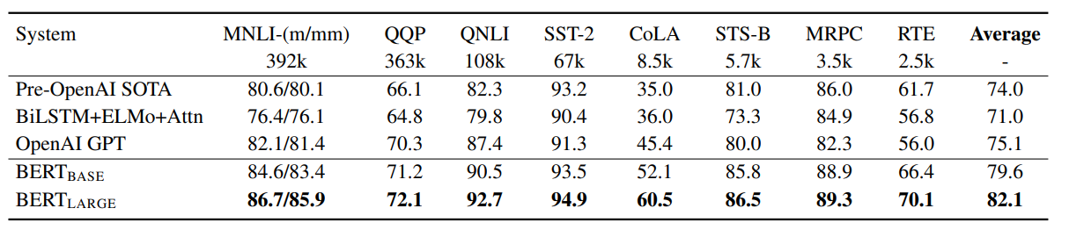
BERT (Results in different tasks)
Leaderboards

Slide 89
Common NLP tasks

Slide 90
Overview
Text and speech processing
Morphological analysis
Syntactic analysis
Lexical semantics (of individual words in context)
Relational semantics (semantics of individual sentences)
Discourse (semantics beyond individual sentences)
Higher-level NLP applications

Slide 91
Text and speech processing
Speech recognition: Given a sound clip of a person or people speaking, determine the textual representation of the speech
Text-to-speech: Given a text, transform those units and produce a spoken representation
Word segmentation (Tokenization): Separate a chunk of continuous text into separate words

Slide 92
Morphological analysis
Lemmatization: Removing inflectional endings only and to return the base dictionary form of a word
Stemming: Same with lemmatization but doesn’t always return a valid word
Part-of-speech tagging: Given a sentence, determine the part of speech (POS) for each word

Slide 93
Syntactic analysis
Grammar induction: Generate a formal grammar that describes a language's syntax
Sentence breaking: Given a chunk of text, find the sentence boundaries
Parsing: Determine the parse tree (grammatical analysis) of a given sentence

Slide 94
Lexical semantics
Distributional semantics: How can we learn semantic representations from data
Named entity recognition: Given a stream of text, determine which items in the text map to proper names (e.g. person, location, organization)
Sentiment analysis: Identify and categorize opinions expressed in a piece of text (e.g. positive, negative, or neutral)

Slide 95
Relational semantics
Relationship extraction: Given a chunk of text, identify the relationships among named entities (e.g. who is married to whom)
Semantic Role Labelling: Given a single sentence, identify and disambiguate semantic predicates (e.g. verbal frames), then identify and classify the frame elements (semantic roles)

Slide 96
Discourse
Coreference resolution: Given a sentence or larger chunk of text, determine which words ("mentions") refer to the same objects ("entities")
Topic segmentation and recognition: Given a chunk of text, separate it into segments each of which is devoted to a topic, and identify the topic of the segment

Slide 97
Higher-level NLP applications
Automatic summarization: Produce a readable summary of a chunk of text
Book generation: Creation of full-fledged books
Question answering: Given a human-language question, determine its answer
Machine translation: Automatically translate text from one human language to another

Slide 98
References - papers
Turing, Alan M. "Computing machinery and intelligence." Parsing the turing test. Springer, Dordrecht, 2009. 23-65.
Hutchins, W. John. "The Georgetown-IBM experiment demonstrated in January 1954." Conference of the Association for Machine Translation in the Americas. Springer, Berlin, Heidelberg, 2004.
Weizenbaum, Joseph. "ELIZA—a computer program for the study of natural language communication between man and machine." Communications of the ACM 9.1 (1966): 36-45.
Tappert, Charles C. "Who is the father of deep learning?." 2019 International Conference on Computational Science and Computational Intelligence (CSCI). IEEE, 2019.
Ivakhnenko, Alekseĭ Grigorʹevich, et al. Cybernetics and forecasting techniques. Vol. 8. American Elsevier Publishing Company, 1967.
Bengio, Yoshua, Réjean Ducharme, and Pascal Vincent. "A neural probabilistic language model." Advances in neural information processing systems 13 (2000).

Slide 99
References - papers
Collobert, Ronan, and Jason Weston. "A unified architecture for natural language processing: Deep neural networks with multitask learning." Proceedings of the 25th international conference on Machine learning. 2008.
Mikolov, Tomas, et al. "Efficient estimation of word representations in vector space." arXiv preprint arXiv:1301.3781 (2013).
Sutskever, Ilya. Training recurrent neural networks. Toronto, ON, Canada: University of Toronto, 2013.
Kalchbrenner, Nal, Edward Grefenstette, and Phil Blunsom. "A convolutional neural network for modelling sentences." arXiv preprint arXiv:1404.2188 (2014).
Zhang, Ye, and Byron Wallace. "A sensitivity analysis of (and practitioners' guide to) convolutional neural networks for sentence classification." arXiv preprint arXiv:1510.03820 (2015).
Sutskever, Ilya, Oriol Vinyals, and Quoc V. Le. "Sequence to sequence learning with neural networks." Advances in neural information processing systems 27 (2014).

Slide 100
References - papers
Bahdanau, Dzmitry, Kyunghyun Cho, and Yoshua Bengio. "Neural machine translation by jointly learning to align and translate." arXiv preprint arXiv:1409.0473 (2014).
Vaswani, Ashish, et al. "Attention is all you need." Advances in neural information processing systems 30 (2017).
Weston, Jason, Sumit Chopra, and Antoine Bordes. "Memory networks." arXiv preprint arXiv:1410.3916 (2014).
Dai, Andrew M., and Quoc V. Le. "Semi-supervised sequence learning." Advances in neural information processing systems 28 (2015).
McCann, Bryan, et al. "Learned in translation: Contextualized word vectors." Advances in neural information processing systems 30 (2017).
Matthew E. Peters, Mark Neumann, Mohit Iyyer, Matt Gardner, Christopher Clark, Kenton Lee, and Luke Zettlemoyer. 2018. Deep Contextualized Word Representations. In Proceedings of the 2018 Conference of the North American Chapter of the Association for Computational Linguistics: Human Language Technologies, Volume 1 (Long Papers), pages 2227–2237, New Orleans, Louisiana. Association for Computational Linguistics.

Slide 101
References - papers
Radford, Alec, et al. "Improving language understanding by generative pre-training." (2018).
Devlin, Jacob, et al. "Bert: Pre-training of deep bidirectional transformers for language understanding." arXiv preprint arXiv:1810.04805 (2018).
Rumelhart, David E., Geoffrey E. Hinton, and Ronald J. Williams. "Learning representations by back-propagating errors." nature 323.6088 (1986): 533-536.
Hochreiter, Sepp, and Jürgen Schmidhuber. "Long short-term memory." Neural computation 9.8 (1997): 1735-1780.
Pennington, Jeffrey, Richard Socher, and Christopher D. Manning. "Glove: Global vectors for word representation." Proceedings of the 2014 conference on empirical methods in natural language processing (EMNLP). 2014.
Bojanowski, Piotr, et al. "Enriching word vectors with subword information." Transactions of the association for computational linguistics 5 (2017): 135-146.

Slide 102
References - sites
https://machinelearningmastery.com/natural-language-processing/
https://en.wikipedia.org/wiki/Natural_language_processing
https://en.wikipedia.org/wiki/PARRY
https://en.wikipedia.org/wiki/Head-driven_phrase_structure_grammar
https://www.ibm.com/cloud/learn/machine-learning
https://en.wikipedia.org/wiki/Machine_learning
https://en.wikipedia.org/wiki/Supervised_learning
https://machinelearningmastery.com/supervised-and-unsupervised-machine-learning-algorithms/
https://en.wikipedia.org/wiki/Unsupervised_learning
https://en.wikipedia.org/wiki/Artificial_neural_network
https://en.wikipedia.org/wiki/Deep_learning#History
https://ruder.io/a-review-of-the-recent-history-of-nlp/index.html#2001neurallanguagemodels

Slide 103
References - sites
https://en.wikipedia.org/wiki/Support-vector_machine
https://en.wikipedia.org/wiki/Naive_Bayes_classifier
https://deepai.org/machine-learning-glossary-and-terms/principle-of-maximum-entropy
https://en.wikipedia.org/wiki/Decision_tree_learning
https://en.wikipedia.org/wiki/Random_forest
https://en.wikipedia.org/wiki/K-nearest_neighbors_algorithm
https://en.wikipedia.org/wiki/Hierarchical_clustering
https://en.wikipedia.org/wiki/K-means_clustering
https://www.lexalytics.com/blog/machine-learning-natural-language-processing/
https://machinelearningmastery.com/promise-deep-learning-natural-language-processing/
https://medium.com/analytics-vidhya/understanding-embedding-layer-in-keras-bbe3ff1327ce
https://en.wikipedia.org/wiki/Multilayer_perceptron
https://en.wikipedia.org/wiki/Convolutional_neural_network

Slide 104
References - sites
https://en.wikipedia.org/wiki/Recurrent_neural_network
https://en.wikipedia.org/wiki/Long_short-term_memory
https://colah.github.io/posts/2015-08-Understanding-LSTMs/
https://machinelearningmastery.com/cnn-long-short-term-memory-networks/
https://medium.com/analytics-vidhya/one-hot-encoding-of-text-data-in-natural-language-processing-2242fefb2148
https://en.wikipedia.org/wiki/Bag-of-words_model
http://www.tfidf.com/
https://jalammar.github.io/illustrated-word2vec/
https://jalammar.github.io/illustrated-transformer/
https://jalammar.github.io/illustrated-bert/

Slide 105
Q & A
Thank you very much for your attention!
Contact: Dionisios Karamouzas
dionkara@ece.auth.gr

